Slide 1
Git’n Pro with HTML/CSS

Slide 2
TA = … ?
George Jones
Studied Information Technology at Penn State, currently finishing my Business degree at Lehman College.
Currently working in Healthcare as an Account Manager
License real estate agent
Learned coding briefly in my younger years(Myspace days) and recently graduated a Full-stack development course at a coding bootcamp in 2017.
Worked freelance creating and customizing mock websites for small business owners
In my free time, I practice Muay Thai, music connoisseur and part-time vegan.
Notes:
Enough about you, time to talk about me.

Slide 3
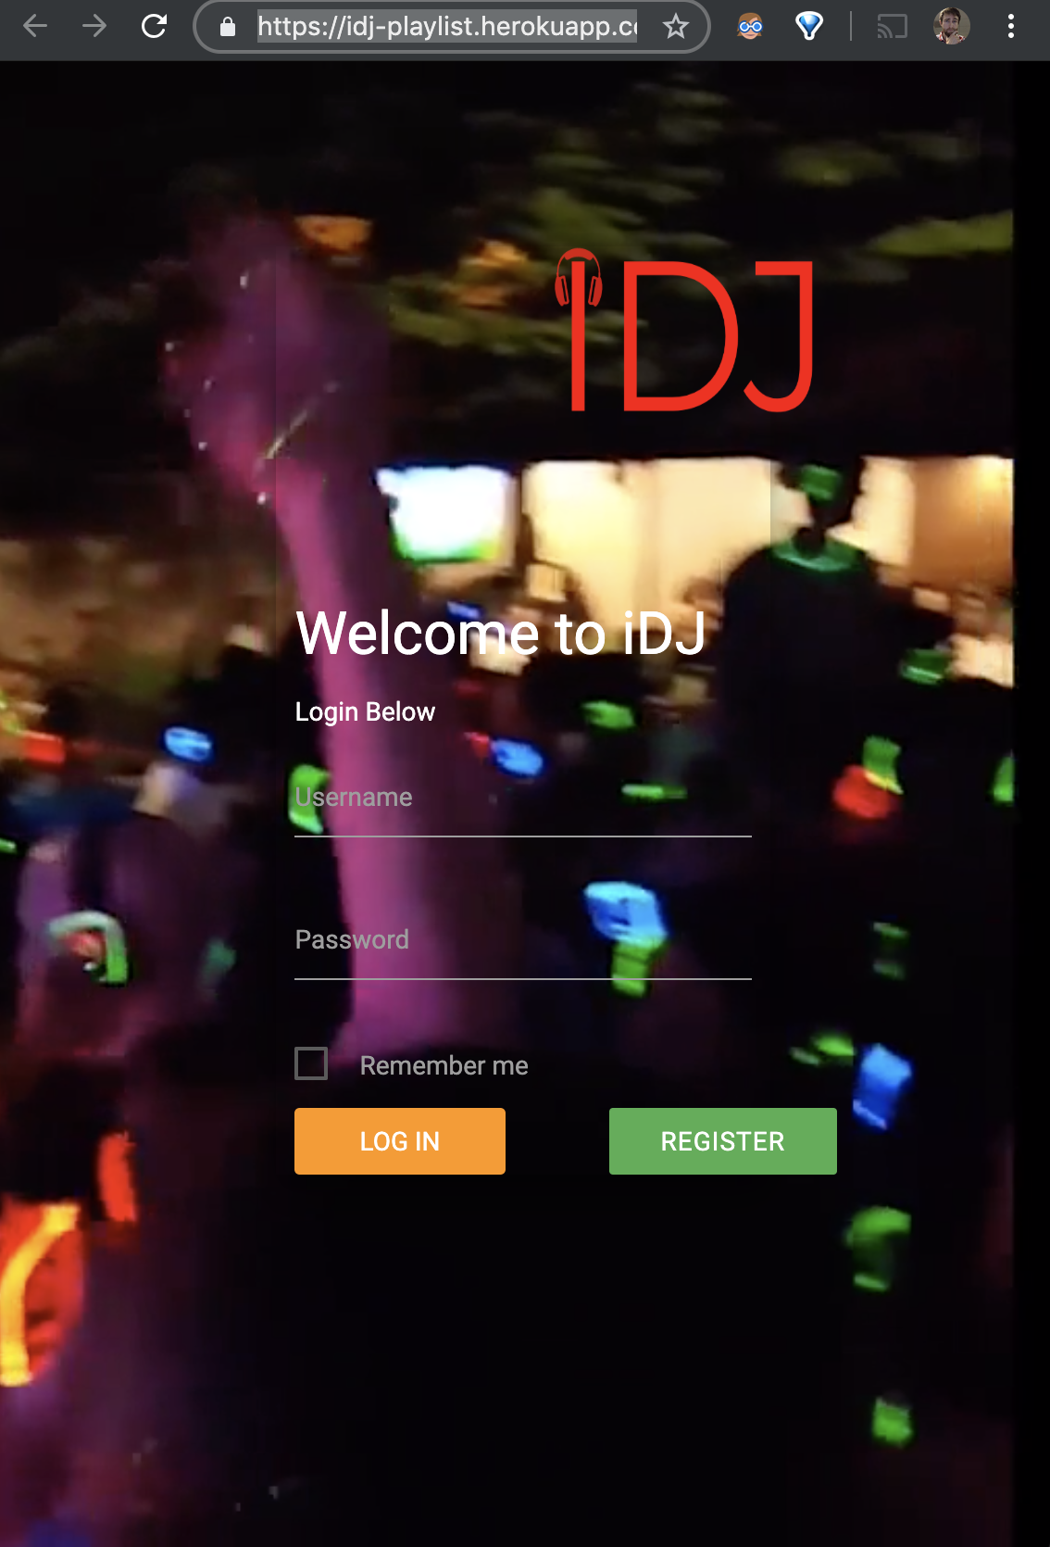


TA = … ?
George Jones
iDJ Web App
Notes:
Enough about you, time to talk about me.

Slide 4
Admin Items

Slide 5
Where to Get Help
Practice, Practice, Practice: Work Individually or in Groups
Review In Class Material (Exercises and Slides): https://columbia.bootcampcontent.com/columbia-bootcamp/COLNYC201904FSF2
Re-Watch Class Videos: https://codingbootcamp.hosted.panopto.com/Panopto/Pages/Sessions/List.aspx?folderID=9a9f2c4f-2788-4da7-8c2d-aa2501673085
In Class Office Hours: 15 minutes before class, 30 minutes after
One-on-One Sessions: By Announcement through SSM
Contact Student Success: Anytime!

Slide 6
Homework #1 - Assignment
Also, at this point everyone should have access to the class content and homework repository (Gitlab)
Homework Assignment #1 is due next week
Due Saturday, April 20, 2019 11:59 PM (Next Saturday)

Slide 7
Today’s Class!

Slide 8
Today’s Objectives
Students will understand the importance of Git Version Control and of how to use it.
Students will create GitHub Repositories, push code into them, and share with class.
Students will make HTML documents.
Students will learn to properly use basic HTML tags
Students will implement basic CSS styling to HTML documents.

Slide 9
Know Thyself
If you are a complete beginner to HTML/CSS and Coding:
Get comfortable with HTML.
Be able to completely write a basic HTML document (like in last class).
Understand what CSS is, what it’s for, and how it works with HTML.
Be able to use Git and GitHub to upload code.
If you’ve had past exposure and felt comfortable with the last lesson:
Aim to build up your skills. Clear up any questions or confusions about HTML.
Become knowledgeable about a wider range of HTML and CSS tags.
Be able to selectively apply CSS to specific HTML elements.
Be able to use Git and GitHub to upload code.

Slide 10
Let’s Get Crackin!

Slide 11

Intro to Console / Terminal
Notes:
The terminal is the portal to your computer – it allows you to run and even script commands that can create files, folders, and more.
It is extremely important that you get intimately familiar with the terminal as soon as possible, as you’ll use it for almost everything. It is fast and powerful.
NEXT

Slide 12
INSTRUCTOR DEMO
Instructor: Demo
(1-ConsoleCommands)
Notes:
So let’s run through a couple of examples.

Slide 13
> YOUR TURN!
Activity: Get Situated | Suggested Time: 1 min
Assignment:
Make a folder on your desktop named code.
Put all of your code that you do inside of that folder.
Best Practices:
Always use lowercase for folder and file names.
Never put in spaces in your folder and file names.
Use dashes to separate.
Notes:
Your turn!

Slide 14
> YOUR TURN!
Activity: Console Commands | Suggested Time: 12 min
Assignment:
From the Terminal / Console and using only the command line, create:
A new folder with the name of first_day_stuff.
A new HTML file with the name of first_day.html.
Open the current folder containing the new HTML file.
Bonus:
Create multiple directories/folders with the names one_folder and second_folder in one command.
Create multiple files with the names one.html and two.html in one command in the first_day_stuff directory.

Slide 15
On the Modern Web

Slide 16

Full-Stack Development?
Notes:
So what exactly does it mean to be a “full stack developer?”

Slide 17

The “Magic” of YouTube
Notes:
Let’s use YouTube as an example. (Go to YouTube and do basic search)
You’ll learn all of this in time, but a basic YouTube search requires two things:
A ”frontend” – the graphical user interface which responds to what I type
A “backend” – the code on the “server side” that is able to do the logic behind the search, find the relevant videos, and send them along
(Go to next slide)

Slide 18
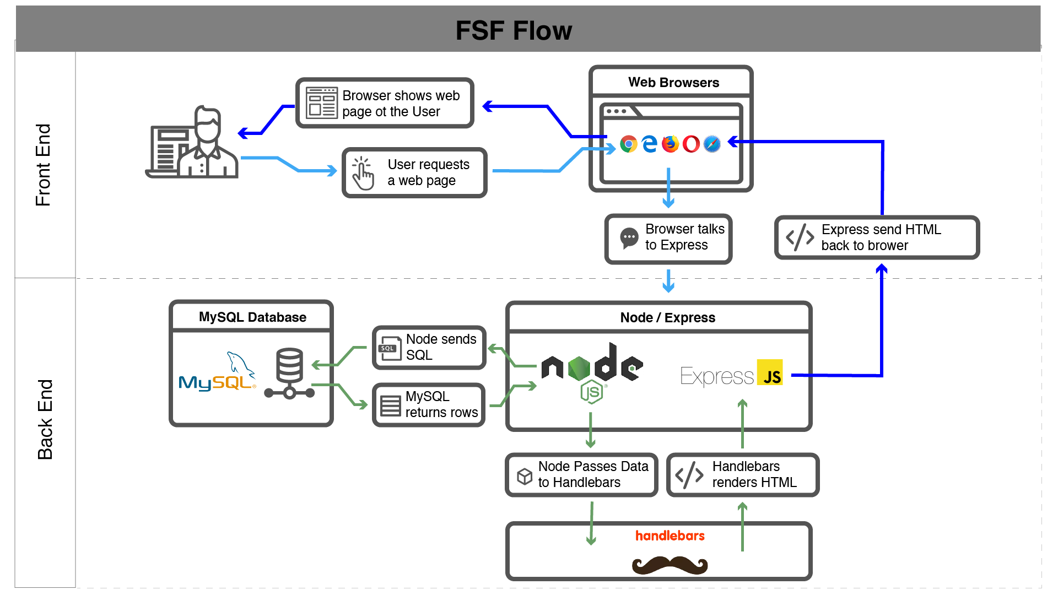
Full-Stack Development
In modern web apps, there’s a constant back-and-forth communication between two key components: the visuals displayed on the user’s browser (frontend) and the data and logic stored on the server (backend).
Notes:
Websites today are all about reading code for these components – “front end” and “back end”

Slide 19
Full-Stack Development
Full-Stack Development is the concept of building every aspect of the web application – from the visuals and interactions, to the data transfer and processing.
Notes:
That is “Full-Stack Development” – you build can and will build the whole thing.

Slide 20
Full-Stack Development
The Browser
Dev Tools
Server Side
HTML
CSS
JavaScript
jQuery
Bootstrap
SEO
Heroku
Git
GitHub
Templating Engines
Sessions
Writing tests
Node.js
Express.js
Creating APIs
MVC
User Authentication
ORM (Sequelize)
Databases
MySQL
MongoDB
API Interaction
APIs (Consuming)
JSON
AJAX
Real Time Cloud Database via Firebase
Algorithms
Design Patterns
CS Fundamentals
Cutting Edge Development
React.js
Notes:
In this course, you’ll learn everything you need to be able to do this –
you’ll be able to build complex web applications even as a single developer.
Questions?

Slide 21
Hello, HTML
Notes:
Now that you can create HTML files from the terminal, let’s create one and actually write some HTML.

Slide 22


<title> Intro to HTML </title>
HTML is one of the three base languages behind every single website.
It defines all of the basic content and a bit of formatting.

Slide 23
> YOUR TURN
Assignment:
In a new HTML file, create the basic structure of an HTML document and include the following in it:
DOCTYPE declaration.
Head tag with a title tag.
H1 tag with a title of your choice.
Embed an image.
Create the following three links on your page:
One link that has target="_blank" which opens a new tab when clicked
Make the second link bold.
Make the third link a placeholder so it goes nowhere.
Bonus:
Create an ordered list of steps to make a sandwich.
Create an unordered list of 5 bands/musicians you like.
Create a table with 2 columns (animal class and animal name) and 4 rows of animals.
Use an alternate way of separating links without line breaks.
Embed a YouTube video of your favorite band/musician.

Slide 24

YouTube Video Walkthrough!
https://www.youtube.com/watch?v=ieb6Svbc10E&index=1&list=PLgJ8UgkiorCnMLsUevoQRxH8t9bt7ne14

Slide 25

<title> Intro to HTML </title>
How’d it go?

Slide 26
What / Why Git?

Slide 27
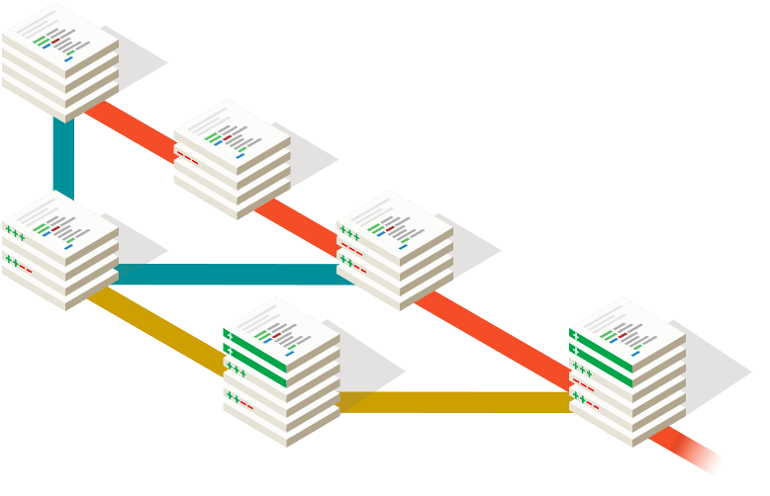
Collaborative Coding
Modern web development is highly collaborative.
Teams are often extremely large and separated across the country — or planet.
Apps sometimes comprise hundreds or even thousands of files.

Slide 28
Let’s Think About It…
What could go wrong?

Slide 29



The Group Project
Lesson:
You should use Version Control.
….and watch your teammates’ work
Through the Git, things you will see. Other branches. The future… the past…
…You will find only what you commit.

Slide 30
Version Control
Git Version Control: Provides an organized system for managing code when multiple developers work on a project
at the same time.
The Benefits of Git:
A process for resolving conflicts in code.
Version History.

Slide 31



The Group Project
Master Branch
Let’s say Yoda, Leia, and Han are all working on different branches for Google.
‘Branch’ = personal copy
Feature branch
Yoda - Maps branch
Leia - Translate branch
Han - Styles branch

Slide 32
The Group Project
If Leia, Yoda, and Han are all working on different branches, they can work separately without affecting each other’s code.
If Yoda added a Maps feature and Leia wants to use this new feature in his code, all Leia has to do is merge in the new version of Yoda’s branch into her own branch and keep coding! (This is much better than the alternative of copy and pasting files)
Always pass on what you have learned.

Slide 33
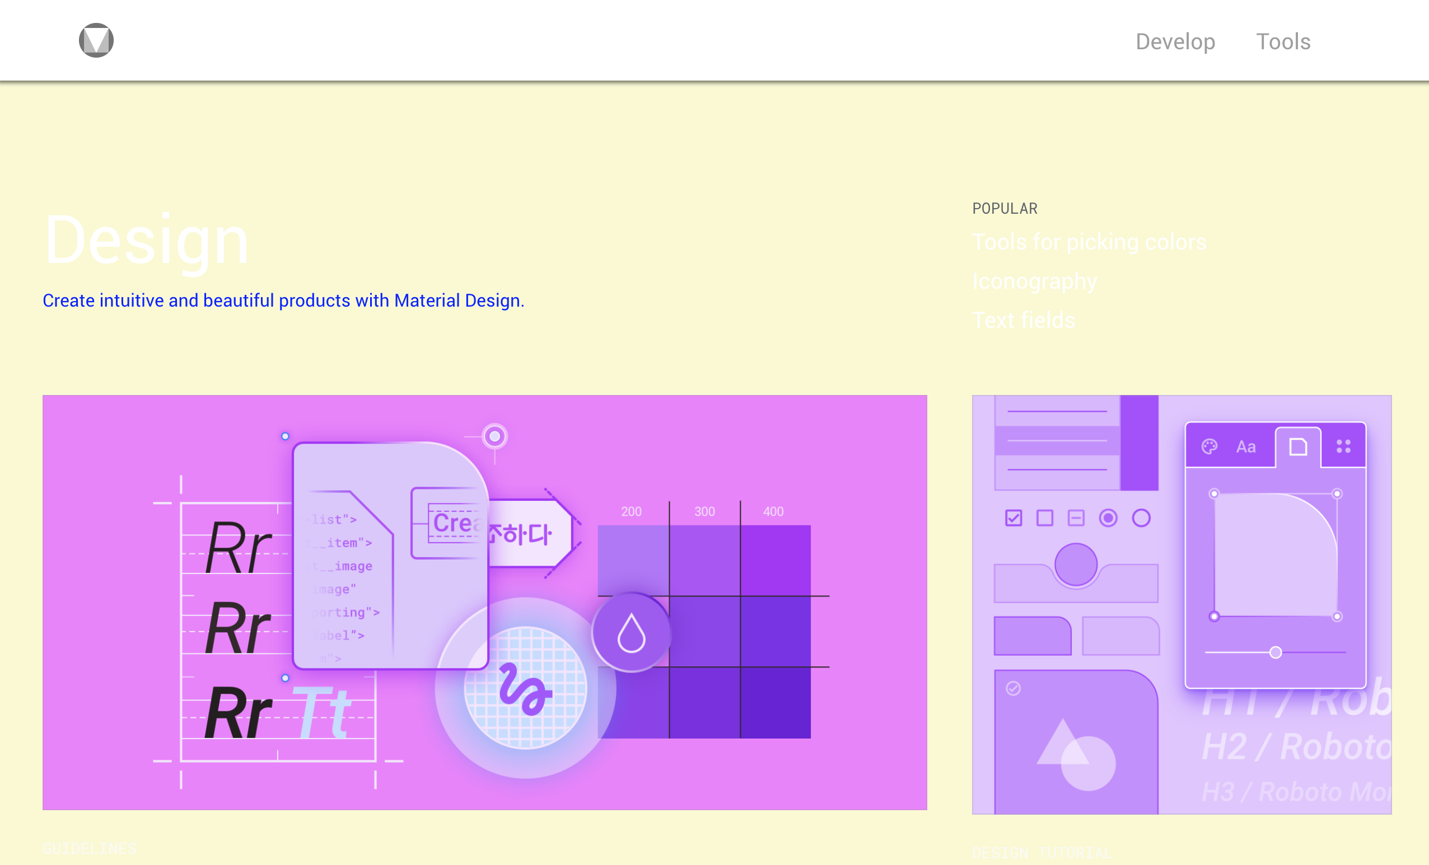
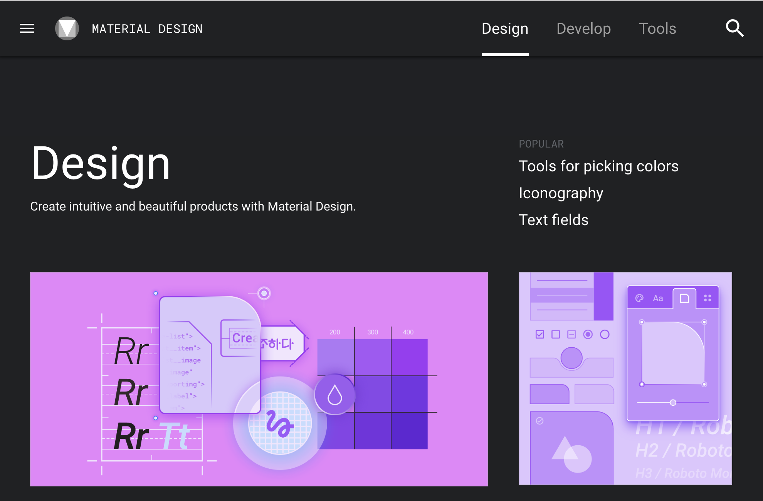
The Group Project
Let’s say Han was working on a site-wide change in styling, but one of his changes had unintended consequences on a page Leia was working on.
Instead of having to debug the problem while users stare at a broken page, Git makes it easy to instantly revert or “rollback” the mistake.
New Broken Version
Old Working Version
Revert

Slide 34
The Group Project
Lesson:
You should use Version Control!

Slide 35
Quick Activity!
Suggested Time: 3 min
Turn to your neighbor, and have one of you explain to the other:
The concept of version control.
Then the other should explain:
Two of the key advantages to using a version control system.

Slide 36

So… What’s this GitHub?
GitHub is a Web-Based hosting service to store code online.
It allows developers to pull (download) code or push (upload) code to the same repository (directory).
It also allows developers to view histories of code changes and to track issues.

Slide 37
So… What’s this GitHub?
GitHub also serves as a social network for developers and their code.
It allows developers to freely contribute to open source projects and discuss issues/features.

Slide 38
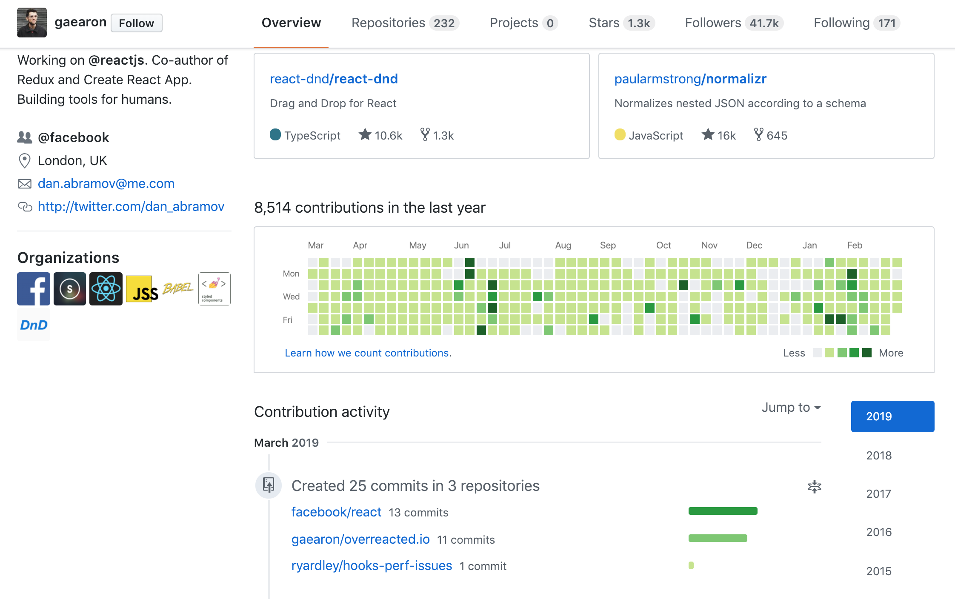
So… What’s this GitHub?
GitHub is a great way to showcase your work.
Hiring managers check GitHub activity and samples to evaluate candidates.
Seeing regular activity shows recruiters that you're continuously learning and developing.

Slide 39




To Sum It Up…
• Think of GitHub like Dropbox for Git. It serves as a backup for your repository and allows you to share your code with other people.
One big advantage GitHub has over a tool like DropBox is that there are many builtin tools to help with developers with collaboration.
• Remember, both Git and GitHub aren’t tied to specific programming languages. For our purposes, we’ve been using code examples, but they could just as easily be image files or PowerPoint presentations.

Slide 40
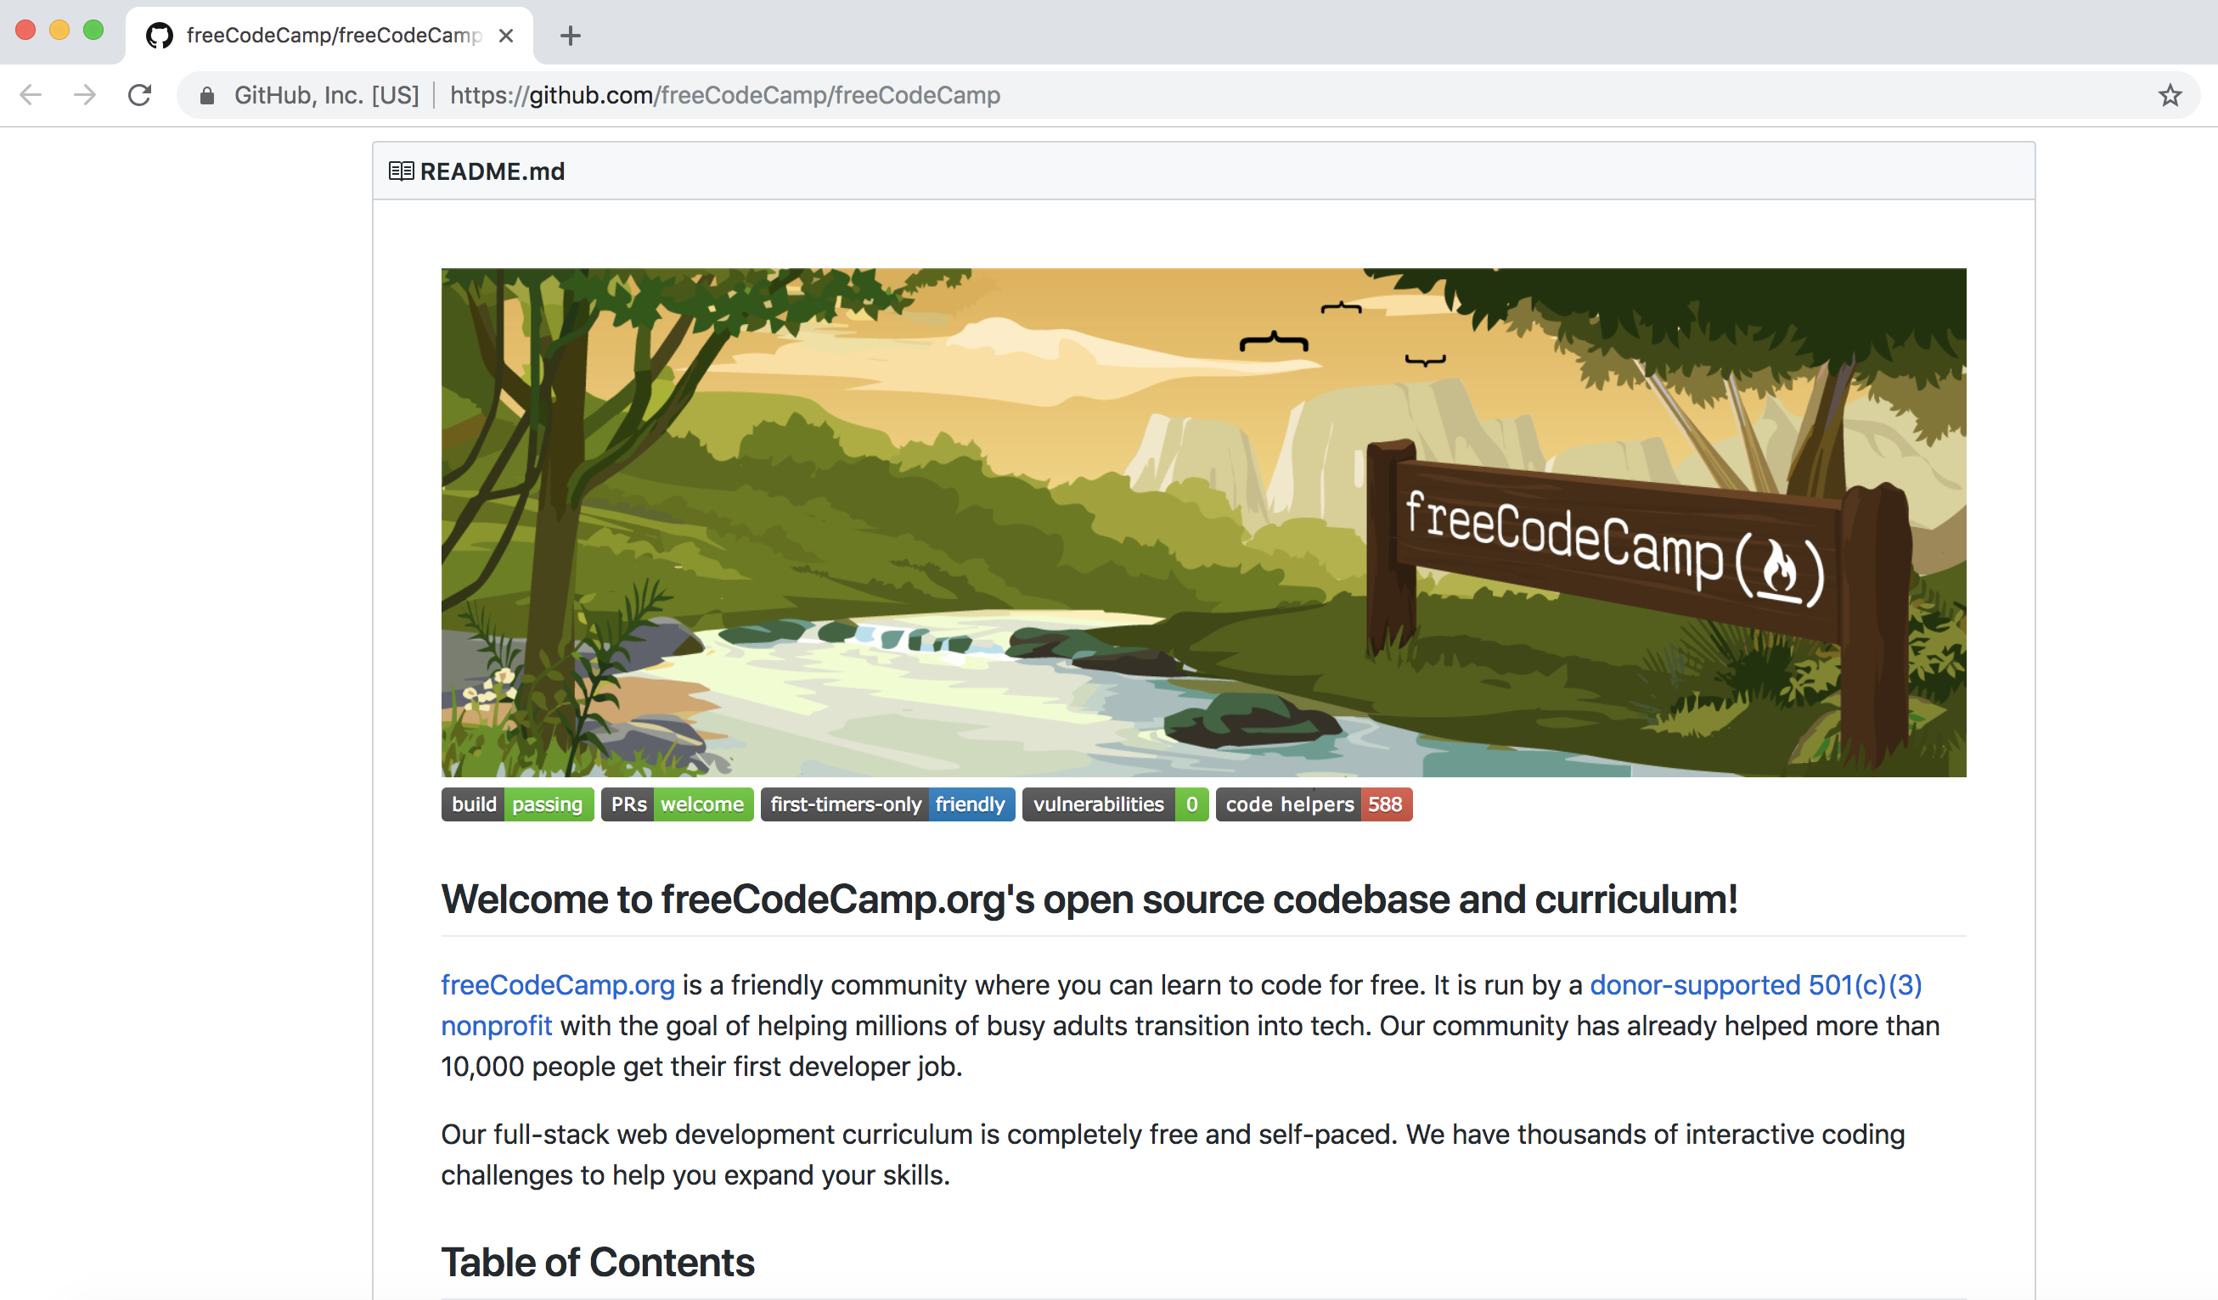
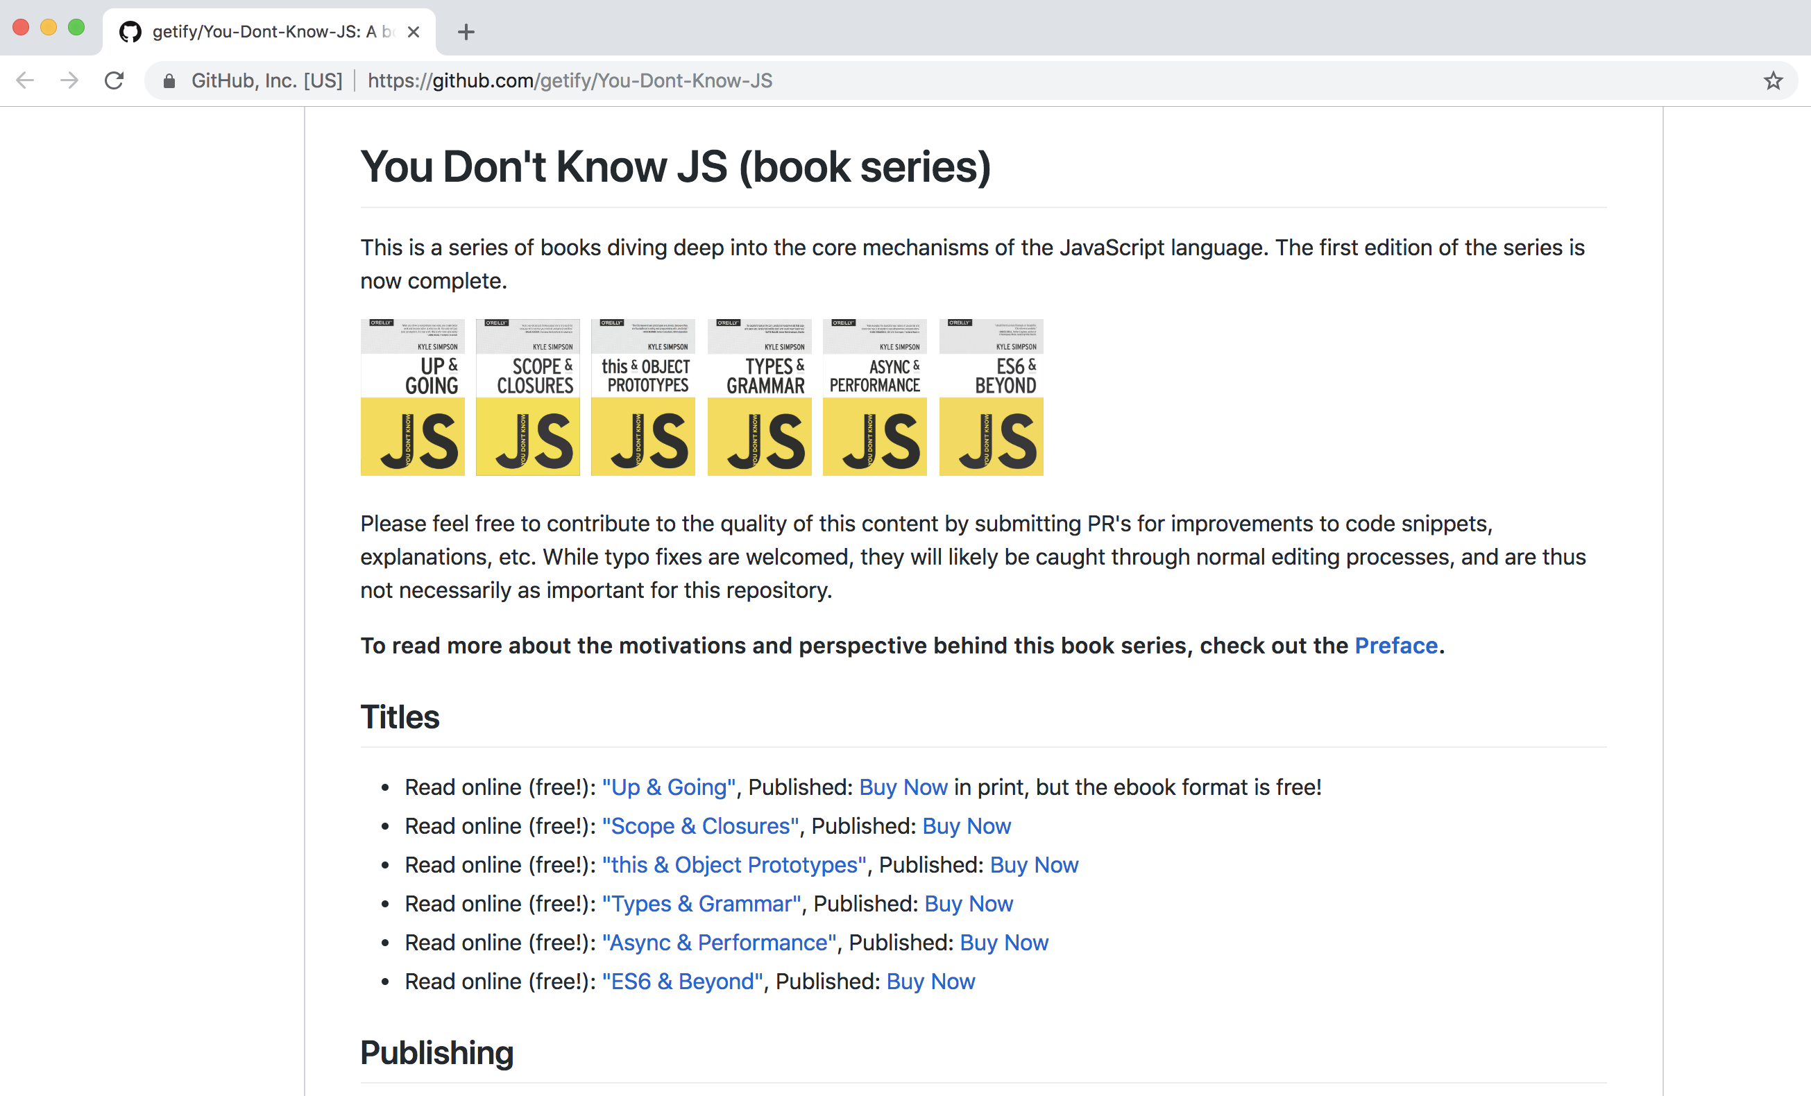
GitHub Examples
Repos…
Repos everywhere…

Slide 41
Get Started with Git

Slide 42
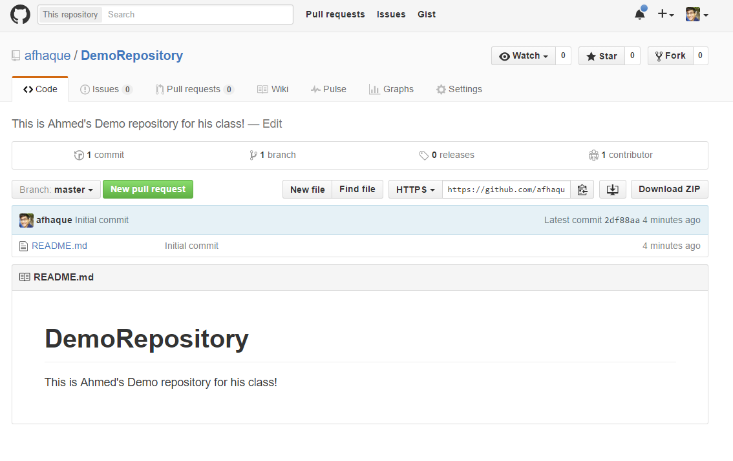
Instructor Git Demo!

Slide 43
Basic Git Commands
At its most basic, these are the five git commands to get started:
git clone
git add
git commit
git push
git pull

Slide 44
Basic Git Commands
At its most basic, these are the five git commands to get started:
git clone – copies an entire repo, while establishing a connection between a local and remote repo.
git add – tells git to track one or more files.
git commit – notes a change to the local repo.
git push – sends changes to a remote repo.
git pull – downloads freshest version of the repo (from a remote repository) into the local repo.

Slide 45
Homework “Due”: Next Class
By Next Class:
Figure out where the GitHub Repo is for our class.
Re-do the Terminal example from class today.
Re-do the HTML example from class today.
Watch the Walkthrough Video if you felt a bit lost.
Create additional git repos, test doing clones, pulls, commits, pushes.

